Slide 1
Networked Radiation Sensor
Sawaiz Syed, Dr. Xiaochun He

Slide 2
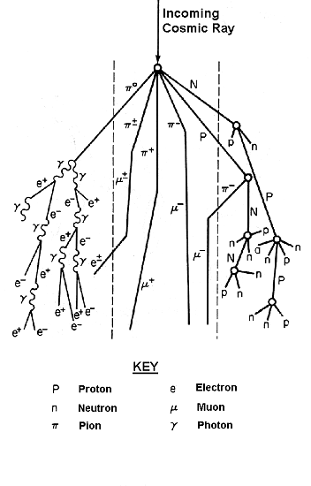
Introduction
Cosmic Rays
Current Options and technologies
City infrastructure
Education
Workplace
Notes:
Ci
Education- Instrumentation Expensive
Health and Safety, workplace

Slide 3
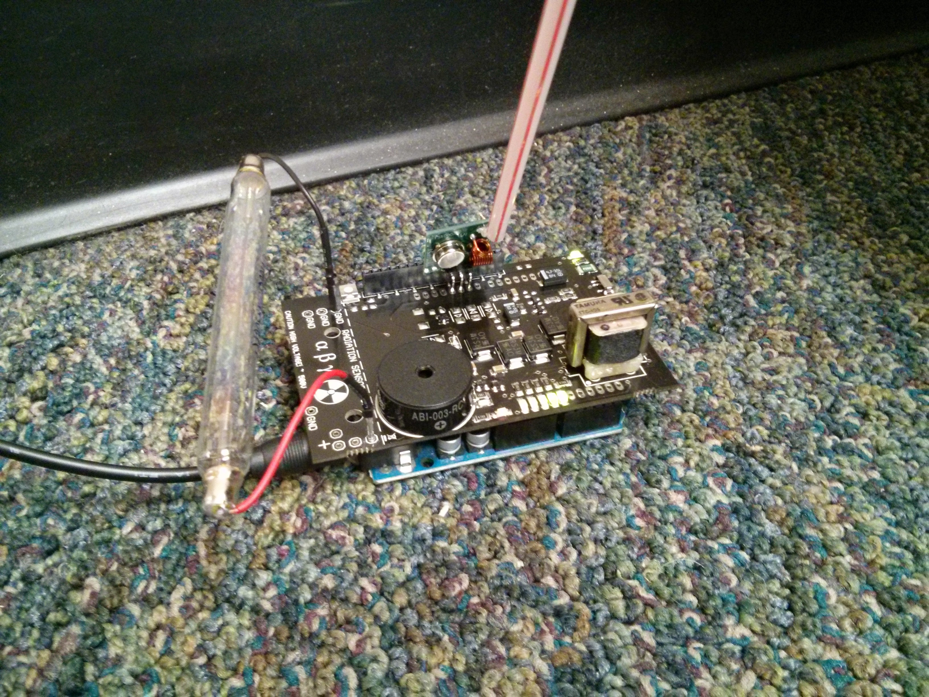
Methods
Hardware Selection
Microcontroller
Wireless
Sensor
Power
Casing

Slide 4
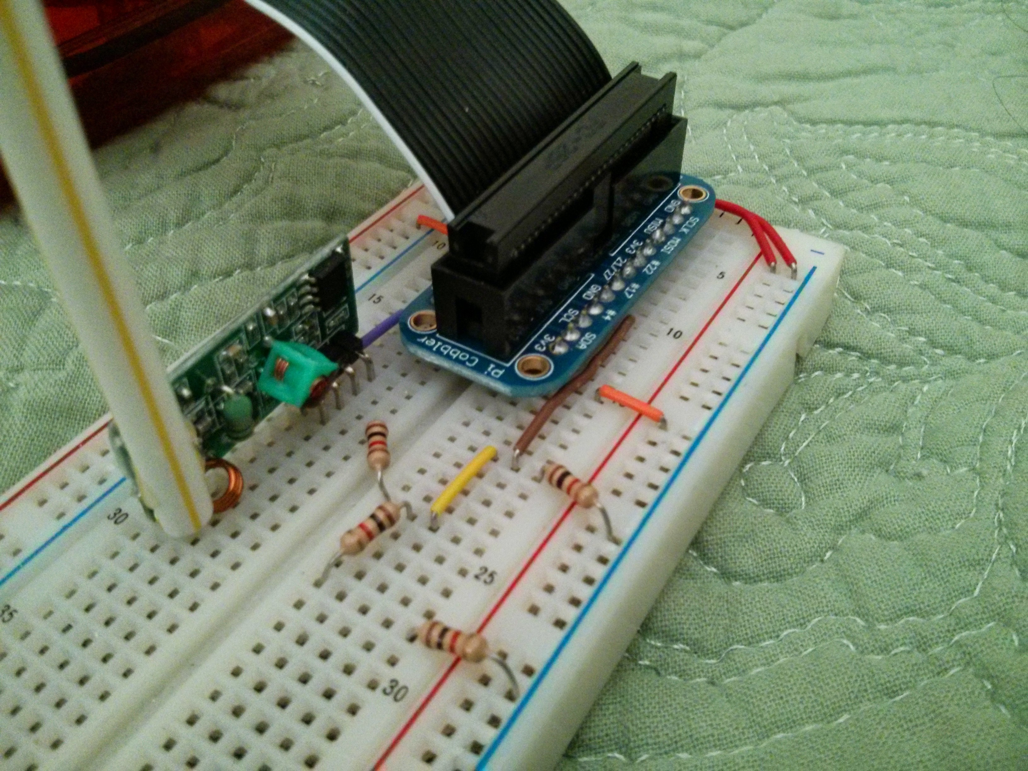
Methods
Software
Sleeping unless awoken by transmitter
Encodes data, and calculates parity byte
Server
Takes in data, timestamps it and stores it on networked SQL drive.

Slide 5
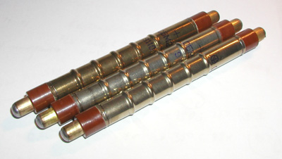
Results
Range Test
Reliability
Power Consumption
Cost
Notes:
Projected Cost – 30
Projected power uA
14/13500, 10bp

Slide 6
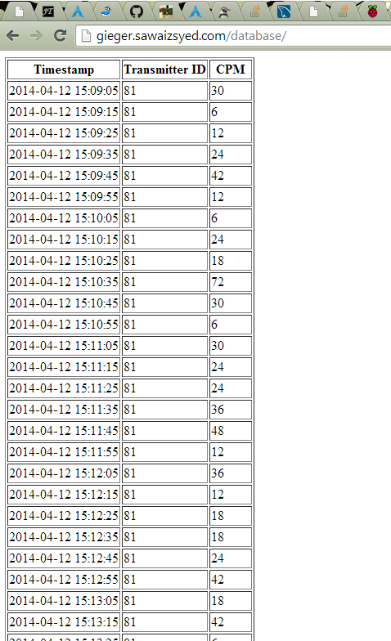
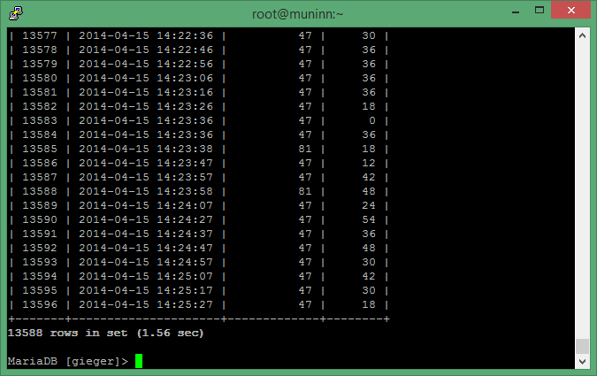
Database

Slide 7
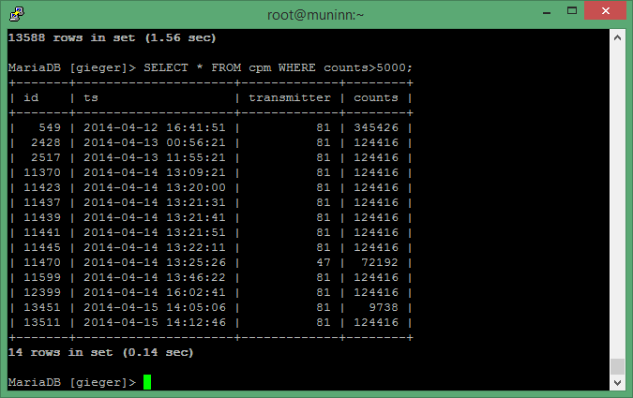
Errors

Slide 8
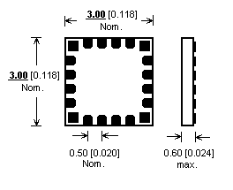
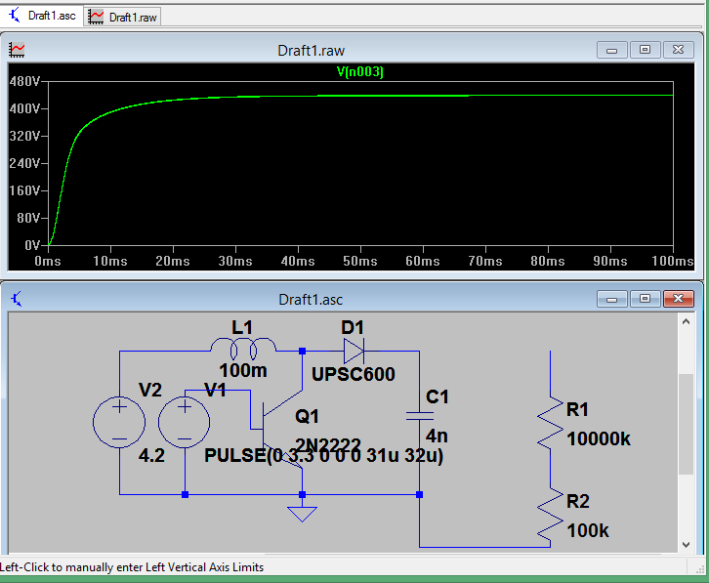
Production (Next Steps)
High Voltage Circuit
SMD PCB
RF chips
Notes:
HV circuit will reduce cost

Slide 9
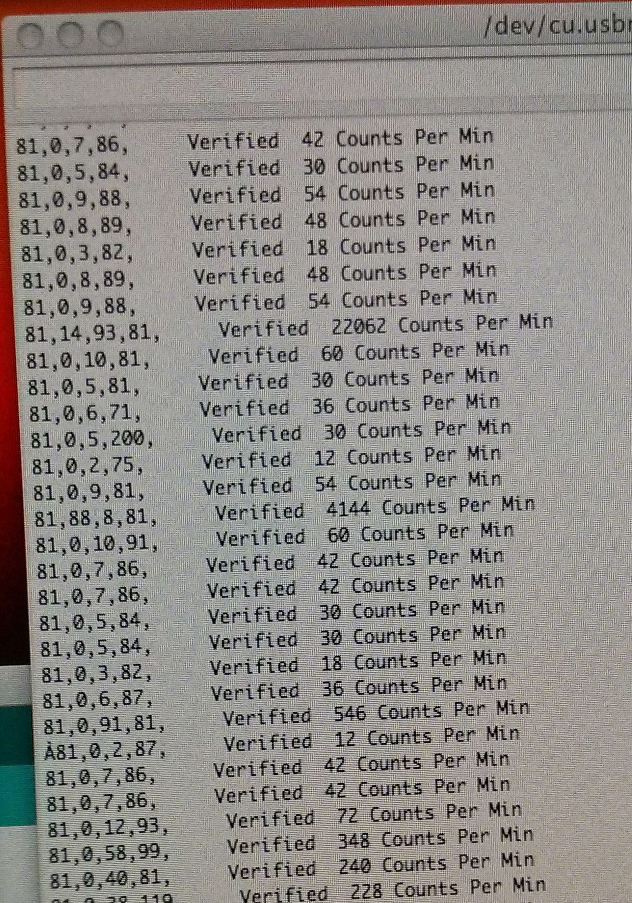
Demo

